Slide 1
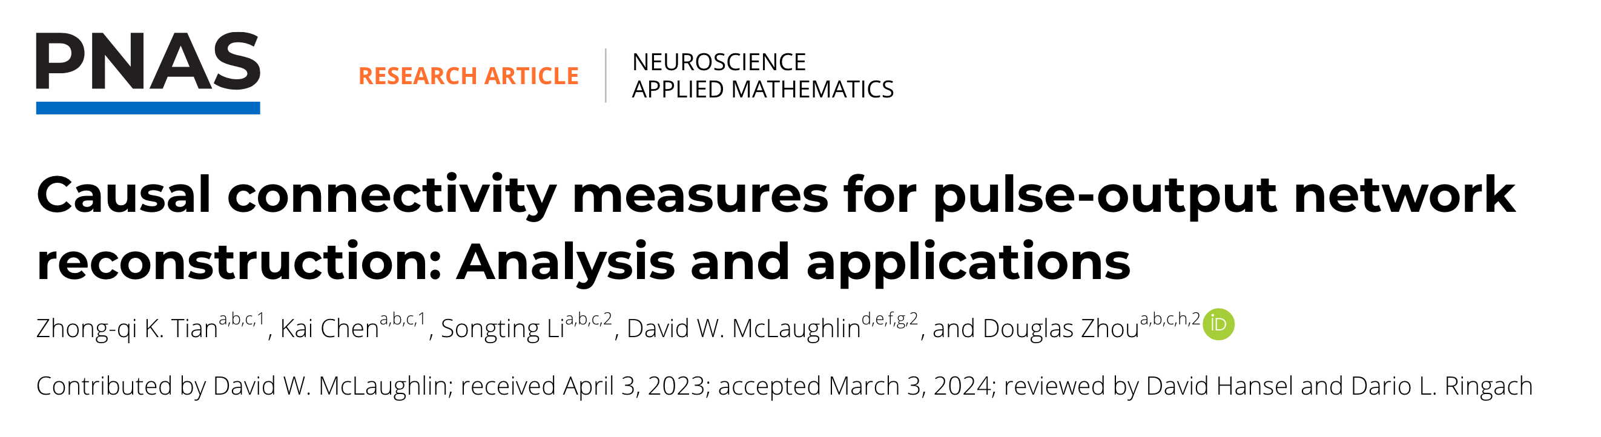
Causal connectivity measures for pulse-output network reconstruction
presented by 张博涛

Slide 2
1.Background
2.Relations between Causality Measures(mathematical)
3.Verification in HH models
4.Application: reconstruction from physiological data
5.Discussion

Slide 3
Background
network connectivity
?
causal connectivity
structural connectivity
different causality measures may produce differnt results
in pulse-output networks they are related
different nature of ‘causal’ and ‘structural’
X->Y->Z, then there’s causal relations from X->Z
computation relying on the whole network is costly
pairwise reconstruction

Slide 4
Background
Four measures for Causal Interactions(connectivity):
TDCC: time-delayed correlation coefficient linear
TDMI: time-delayed mutual information non-linear
GC: Granger causality linear
TE: transfer entropy non-linear but incur curse of dimensionality
overlook historical effects over-estimation

Slide 5
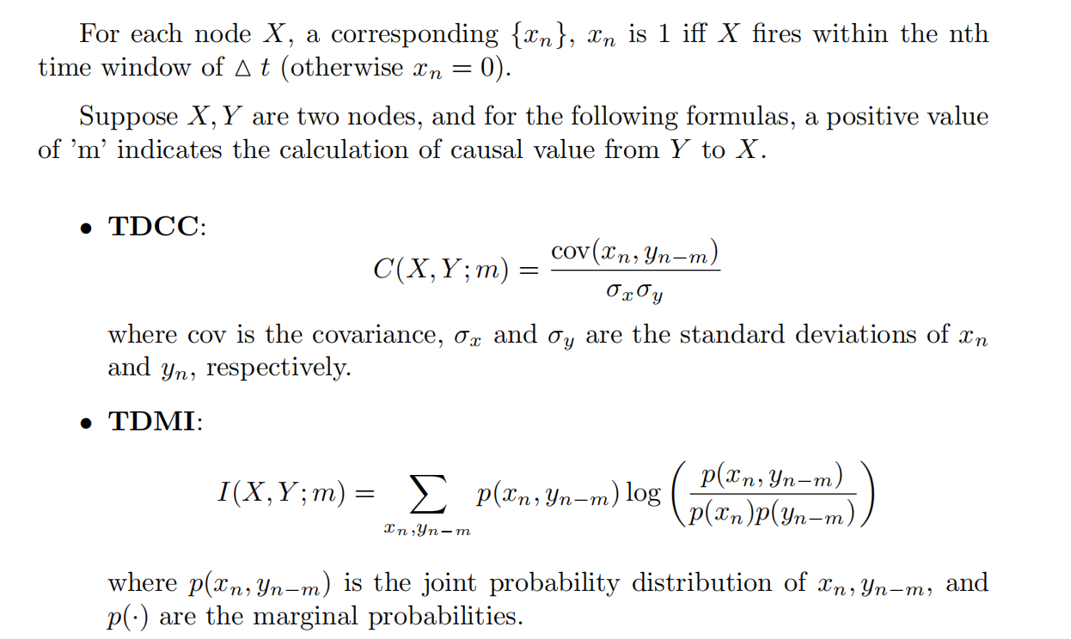
Background

Slide 6
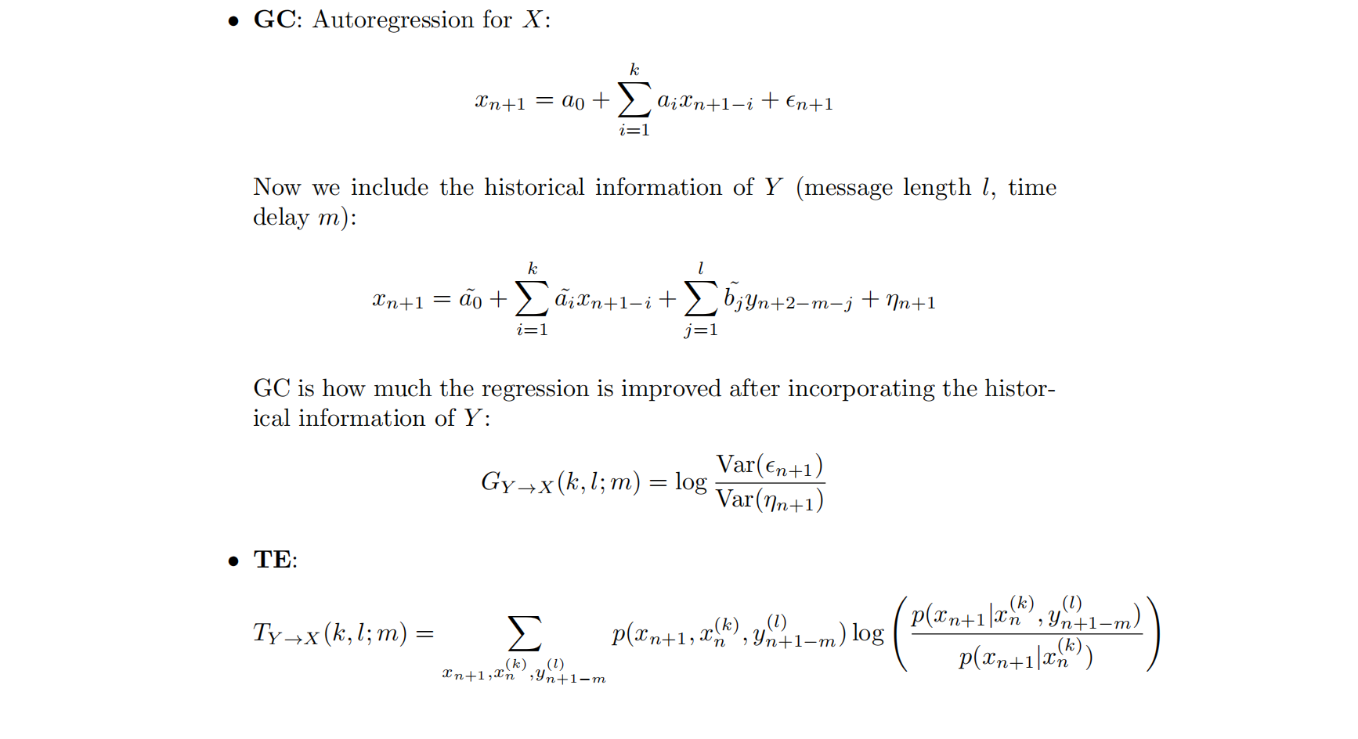

Slide 7
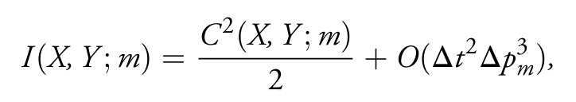

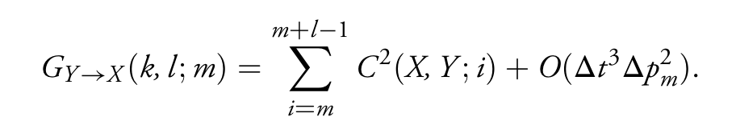
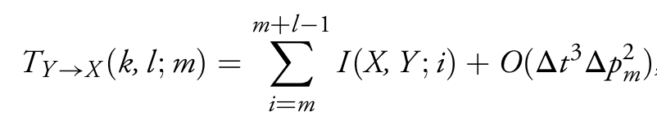
Relations between Causality Measures(mathematical)
with the assumption that length of historical information used is shorter than consecutive spikes’ time interval
proof: Taylor expand
Notes:
delta p_m --> -1的时候，即强抑制的情况，这些关系不再成立，而有另一套等价关系 weak dependence ---> small delta p_m
｜｜x_(n+1)^(k+1)｜｜_0 <= 1, y... 这些关系才成立，但是如果不符合这个条件，他们的这些关系仍然近似地成立;且模拟的时候这个条件一般可以实现

Slide 8

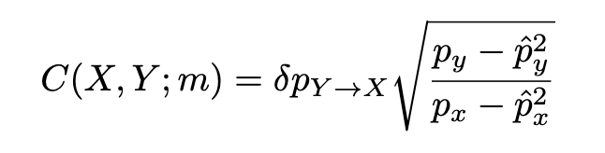
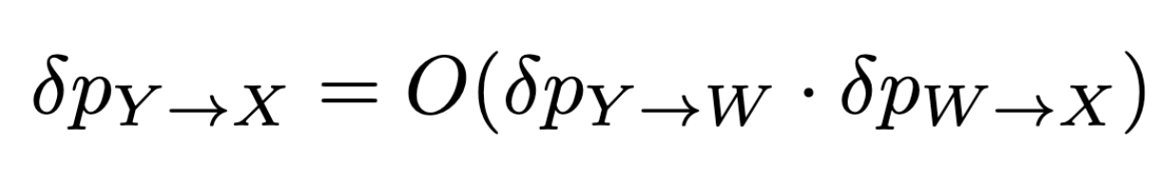
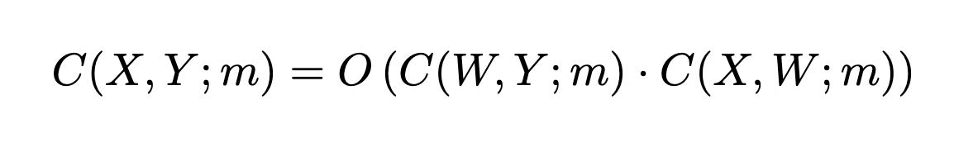
Relations between Causality Measures---Mechanism
id-connected pair (Y,X) might be mis-inferred as d-conn pair by causality measures
Y→W→X
but no problem for pulse-output network:
Y←W→X confounder is resolved the same way
Notes:
in simulation data |delta_p| is very small, < 0.01

Slide 9
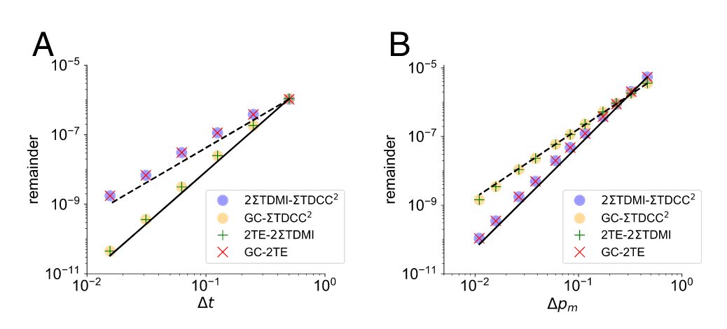
Verification in HH models
d-conn Y→X (in HH with 10 excitatory neurons)

Slide 10
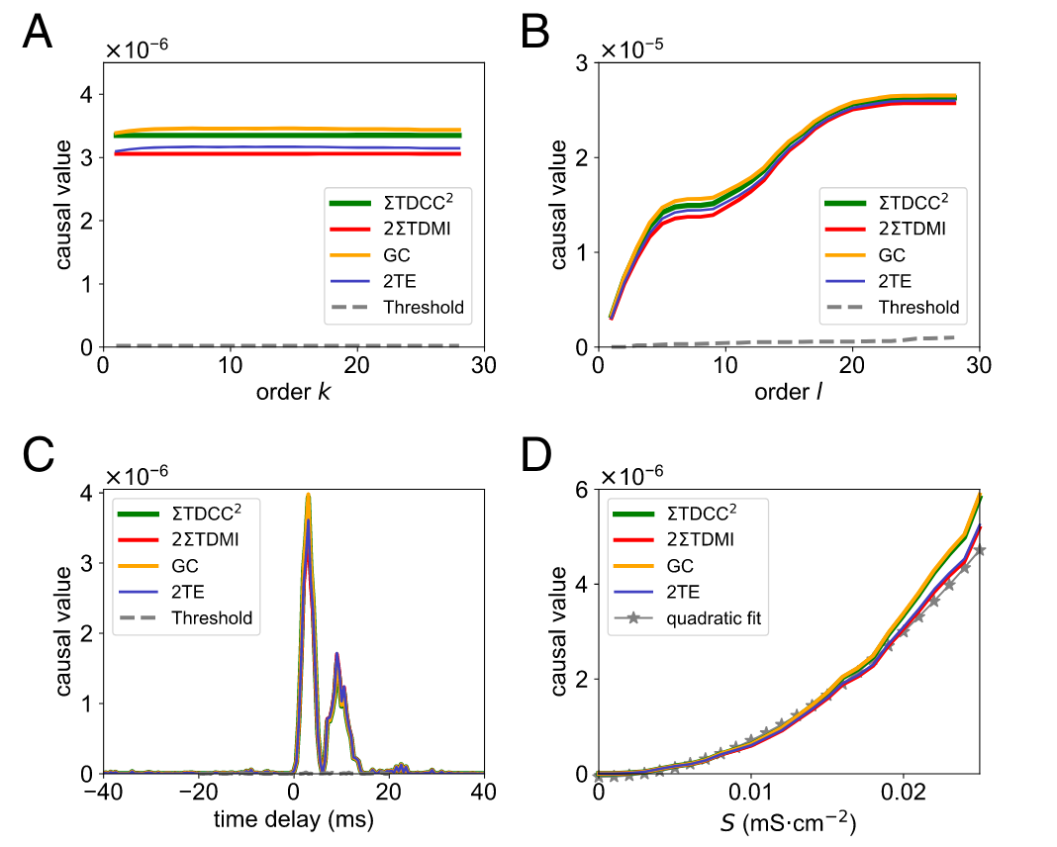
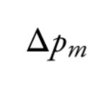
Verification in HH models
d-conn Y→X (in HH with 10 excitatory neurons)
S: coupling strength, linearly related to
Notes:
Fig D: based on quadratic relation, it’s poosible to not only establish 0 or 1 relationships, but also estimate coupling strength; requires further study

Slide 11
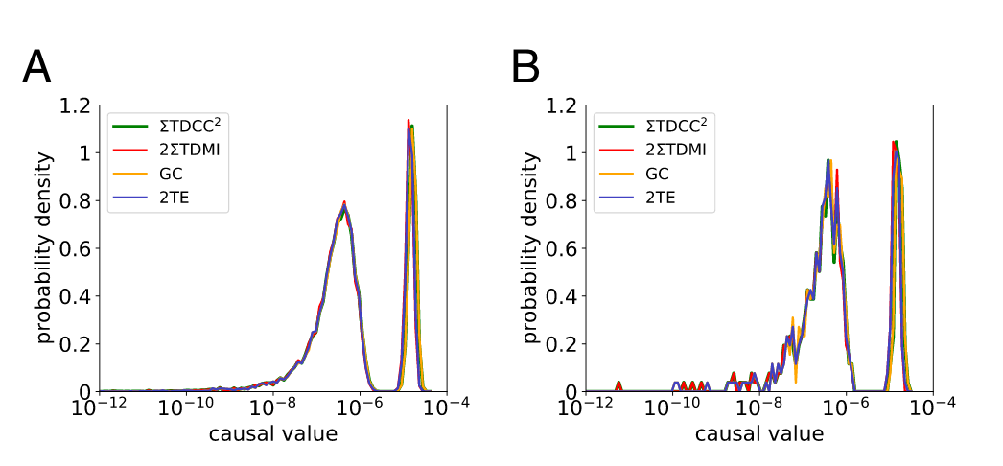
Verification in HH models
a whole HH of 100 excitatory neurons
subnetwork of 20 neurons
id-conn
AUC -> 1
d-conn

Slide 12
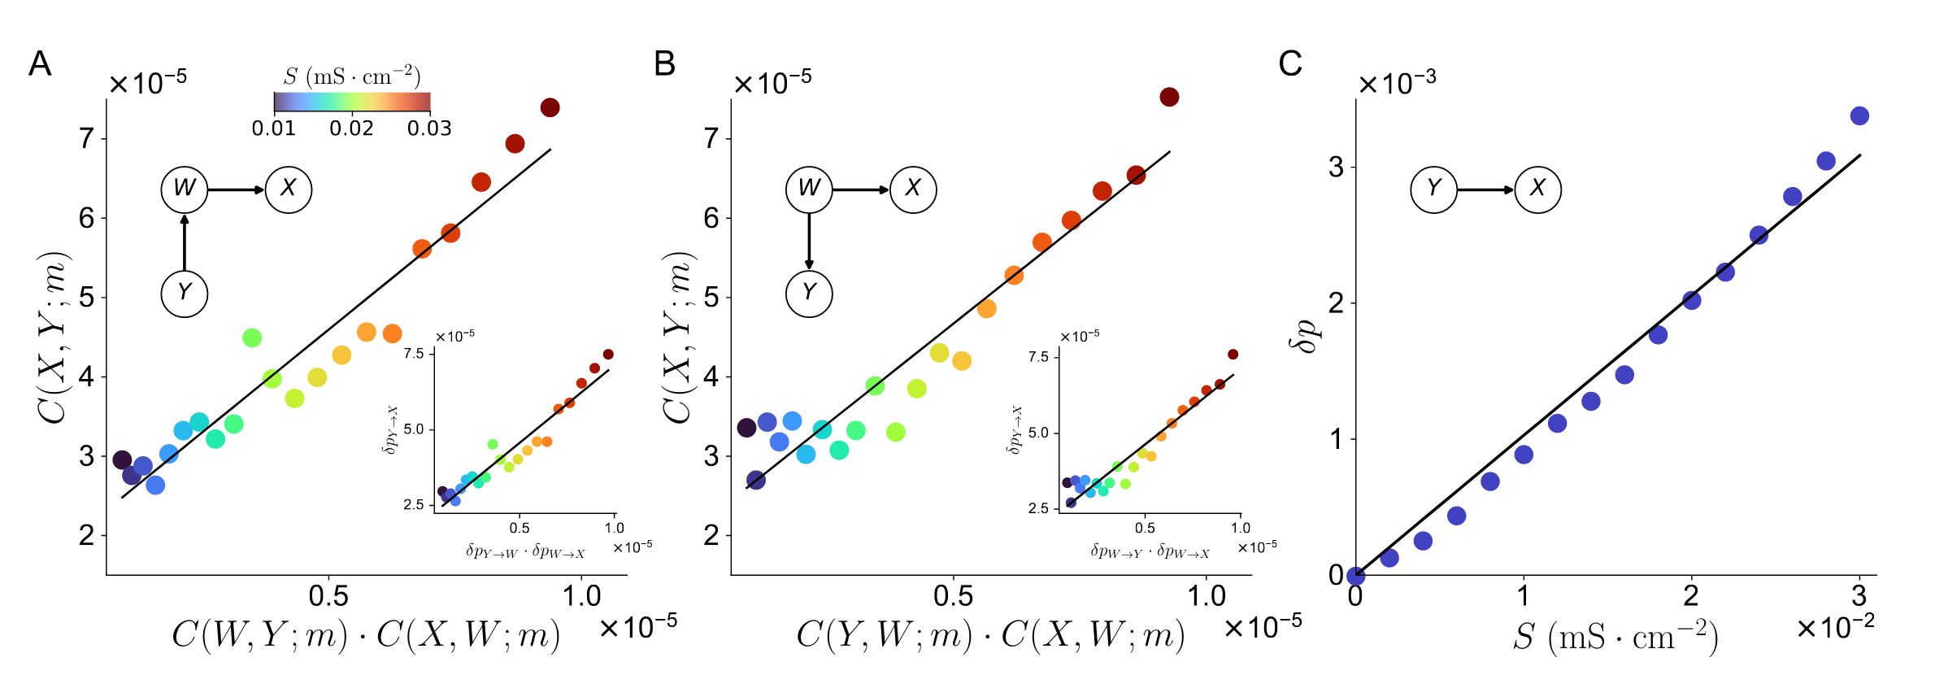
Verification in HH models
linearly dependent on S
Notes:
3 neuron HH

Slide 13
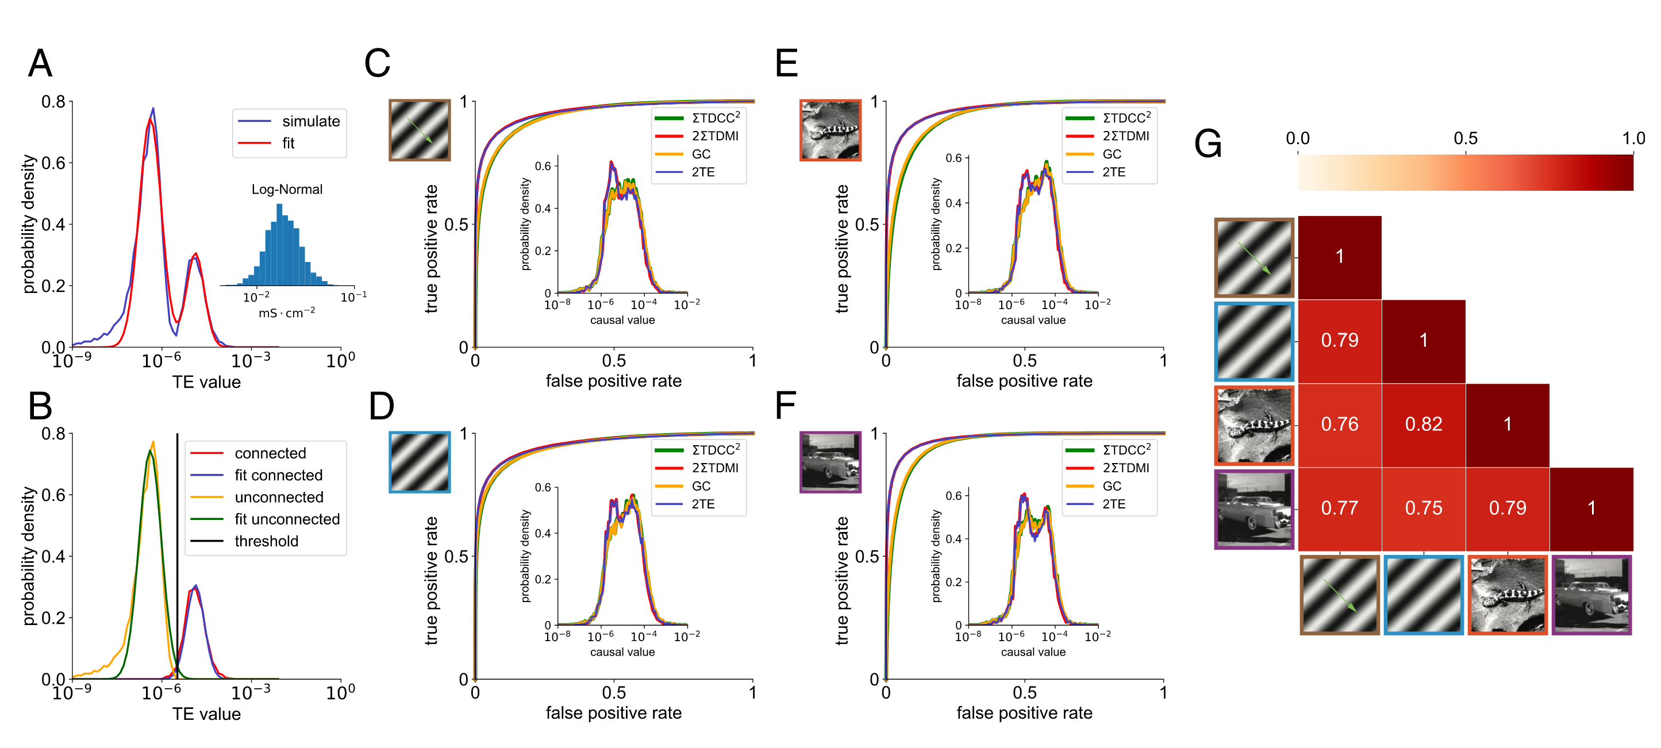
Application: reconstruction from physiological data
similarity matrix of TE values
Notes:
TE proportional to S^2, S log-normal distribution, so TE for d-conn pairs follows log-normal distribution. We also assume it’s the case for id-conn pairs.
这里和前面的bimodal图像，id-conn和d-conn的概率密度变化这么大是S取了log-normal distribution导致的？

Slide 14
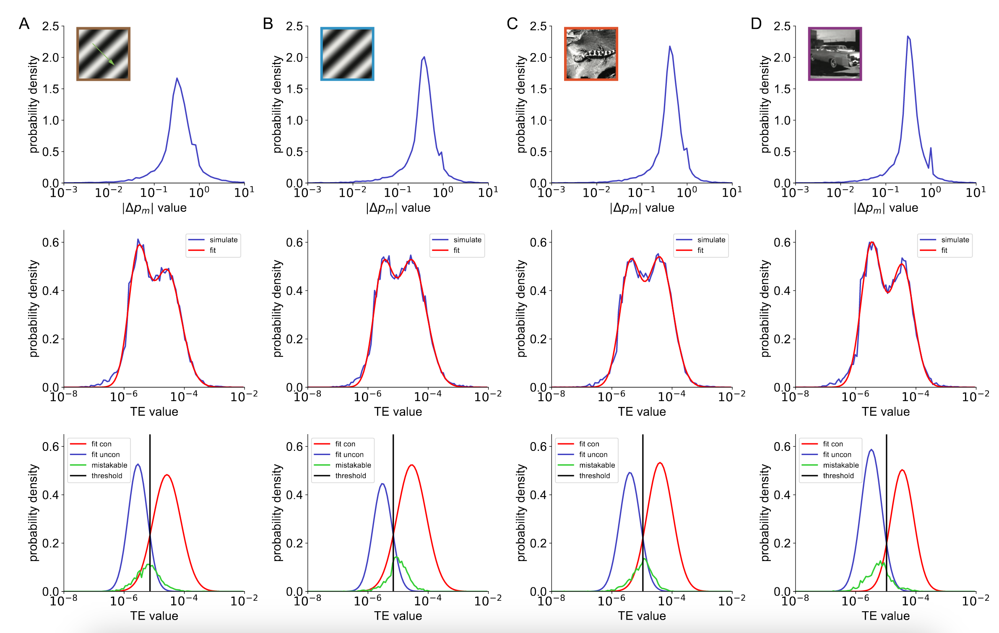
Application: reconstruction from physiological data

Slide 15
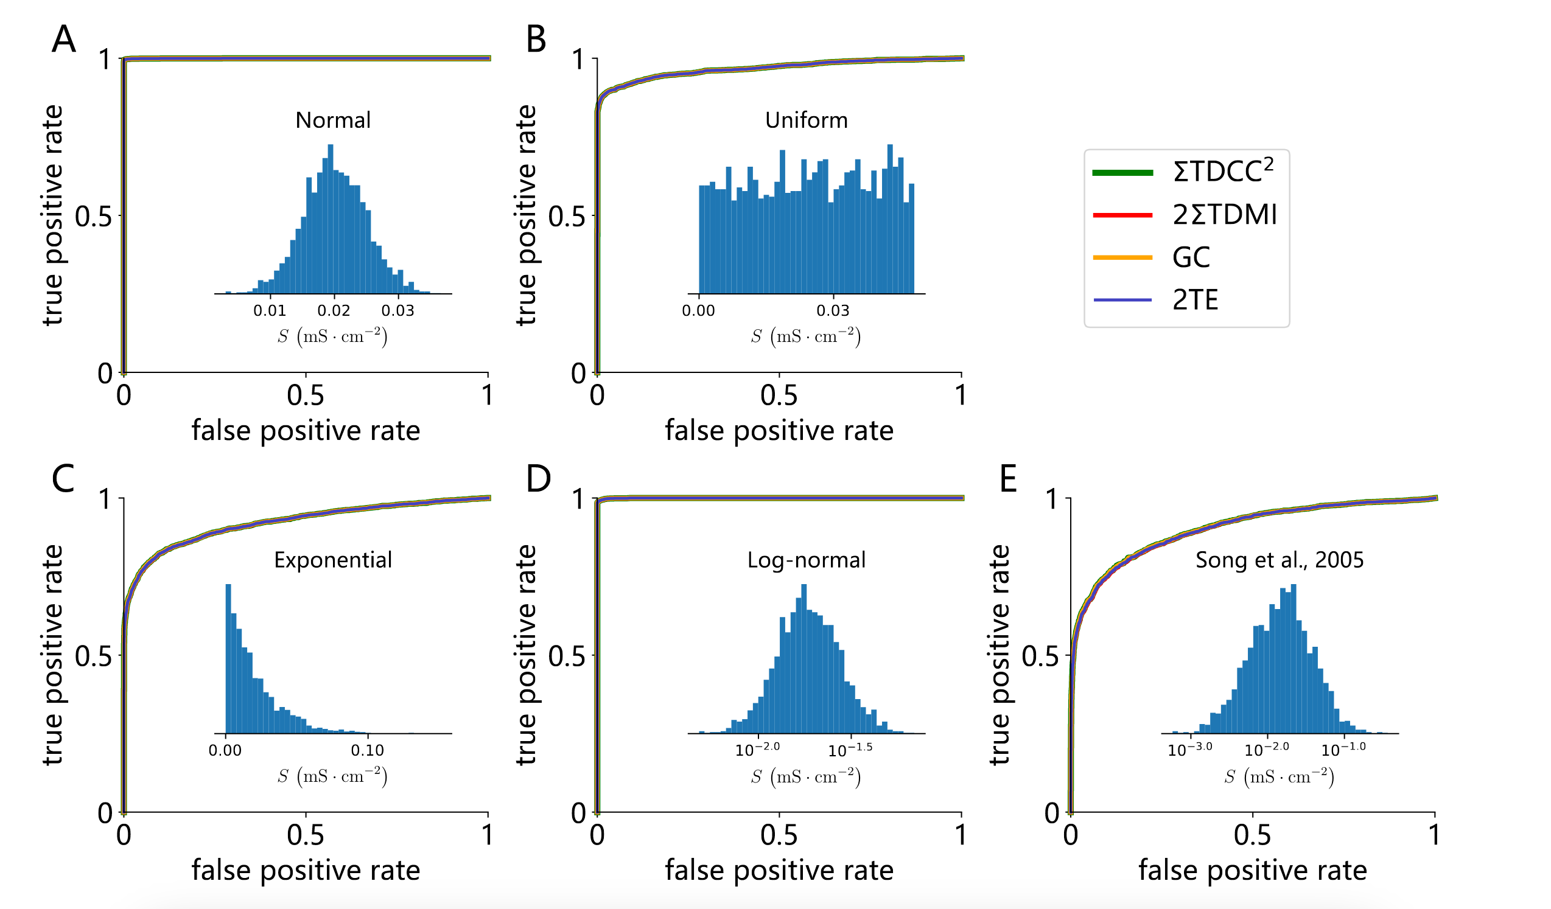
Application: reconstruction from physiological data

Slide 16
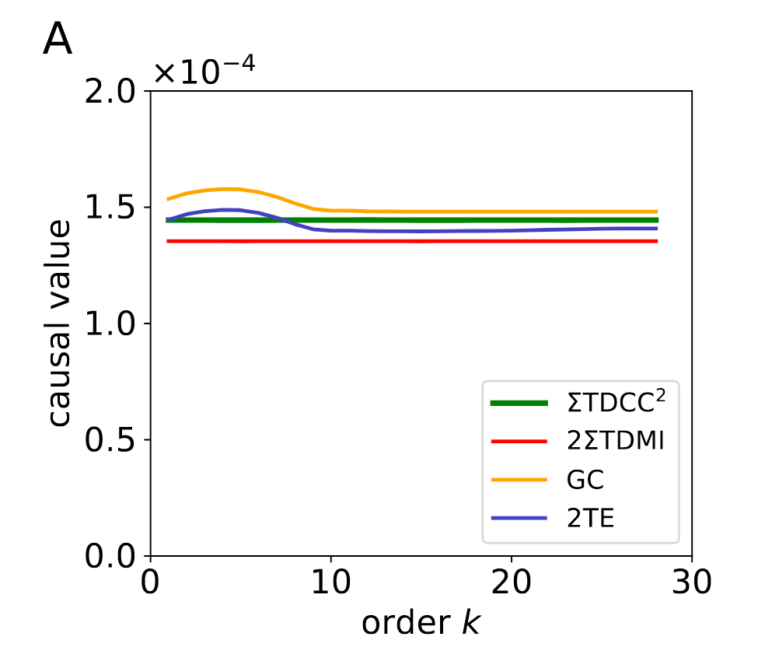
Discussion
Why the method works for pulse-output networks?
Two key features of pulse-output networks:
i) short timescale of autocorrelation
ii) the weakness of indirect causalities
Notes:
i) does not retain memory of its past values for long

